Slide 1
EMPLOYEE MANAGEMENT SYSTEM
Adarsh Bajpai
&
Divyansh Trivedi
Developed By:

Slide 2
EMS
Employee Management System is a distributed application, developed to maintain the details of employees working in any organization.
It maintains the information about the personal details of their employees, also the details about the payroll system which enable to generate the payslip.

Slide 3
EMS Features
An effective employee management system should include key features, such as time and attendance management (e.g., time tracking by way of employee timesheets), absence and leave management (e.g., time-off requests), an employee database, and an employee self-service portal.

Slide 4
Existing system requires manual integration of data and management of different-different processes.
Company requires different systems for Human Resource Information management, Project management and client & Product management.
Searching and tracking of information becomes complex and time consuming.
EMS EXITING System

Slide 5
Need For New System
The new system requires to integrate systems for Human Resource Information , Client management and Project management at one place.
It makes data manipulation of projects & employees easy and fast. Its Less time consuming and provide efficient searching.

Slide 6
PROJECT PROFILE
PROJECT TITLE | Employee Management System
Objectives | System is used to Manage Employees, In Recruitment process choose candidate, Project Management, Client Management at one place
Platform | DJango-Web Application
Front End | Django Framework
Back End | Python 3.8 & Django SQL db
Tools | VS Code
Students Name | Adarsh Bajpai (1864013002) Divyansh Trivedi (1864013011)
Internal Guide | Saumya Awasthi

Slide 7
USER Specification:
Administration
HR Manager
Project Leader
Employee
FUNCTION SPECIFICATION

Slide 8
USER SPECIFICATION
Administrator:-
Administrator can create and manage clients, projects and users.
Administrator can also allocate/change project manager and manage account.

Slide 9
HR Manager:-
HR manager can create/manage employees.
HR manager can also perform selection process of candidates. After selection process candidate will be converted to Employee and new unique Employee ID assigns to Candidate

Slide 10
Project Leader:-
Project Leader creates projects and assign projects to relative Team Leaders.
Project Leader check the project summary & status on dashboard

Slide 11
Employees:-
Team Members are responsible for the work performance and completion in given time period by the Team Leaders.
The reports of work is submitted to the Team Leader and see the latest news of company on dashboard.

Slide 12
MODULES SPECIFICATION:-
There are 4 types of modules:-
1. Account & Administration
2. Human Resource Information
3. Client Management
4. Project Management

Slide 13
Account & Administration:-
Account module provides facility like User Login, Forget Password, Change Password and Creation of New User.
New client details can be added, modified or removed and also adds new employee details.
Create and manage different users and projects.

Slide 14
Human Resource Information:-
It consist:-
Recruitment system
Employee management
Recruitment process where scores of aptitude test, technical interview and HR confirmations can be added and HR manager final selection of candidates.
Employee Management include new employee's user id and modified previous /old Employee Detail

Slide 15
Client Management:-
Customers management :-
Create and update customers profiles with details like Company name, Address, Office email, Office Contact Number etc.
Latest News Section:-
Send News letters to Company clients for products updates
Set Latest news of company which will be displayed on employee's Dashboard

Slide 16
Project Management:-
Project
Project Leader:-
Assign
Assign projects
Assign
Assign Team mamber to Projects
Check
Check project summary & status
Team
Team Member:-
Check
Check assigned projects and Update relevant status
See
see company news

Slide 17
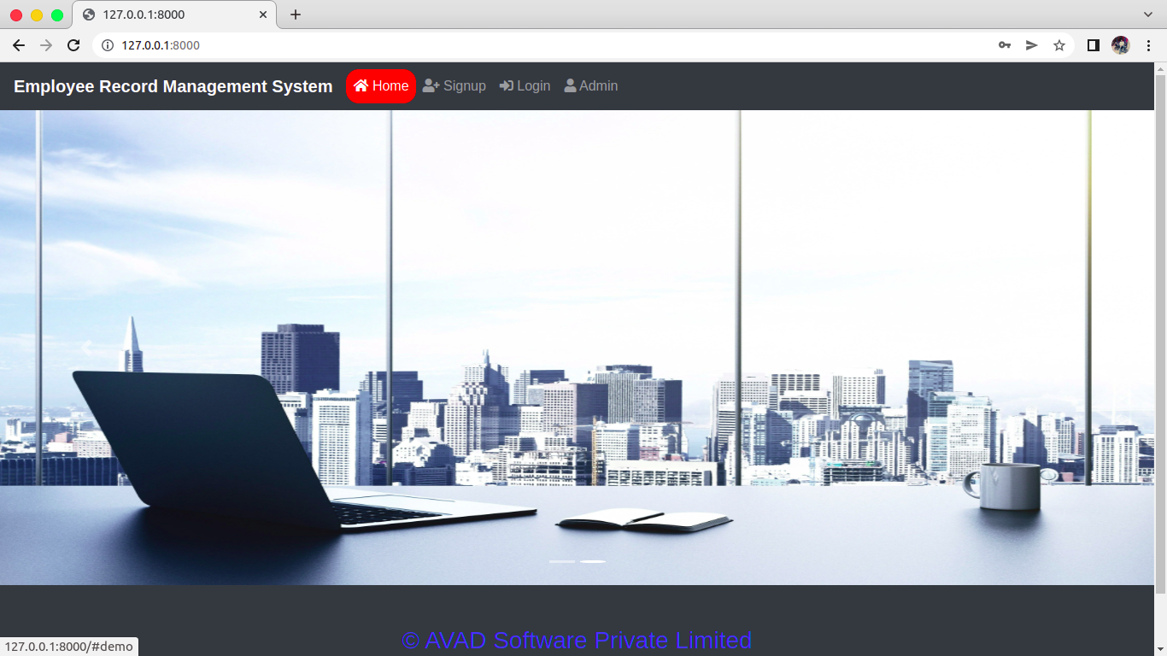
Home Page of EmS

Slide 18
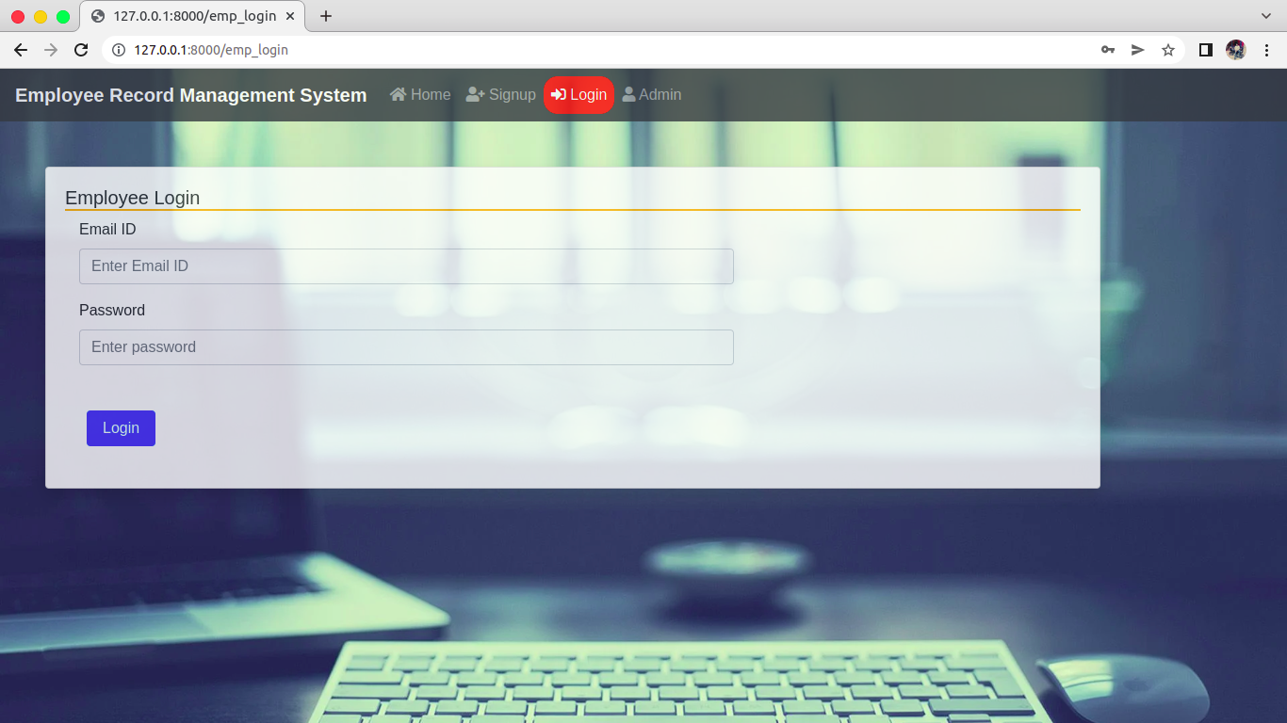
Input Design This page is login page

Slide 19
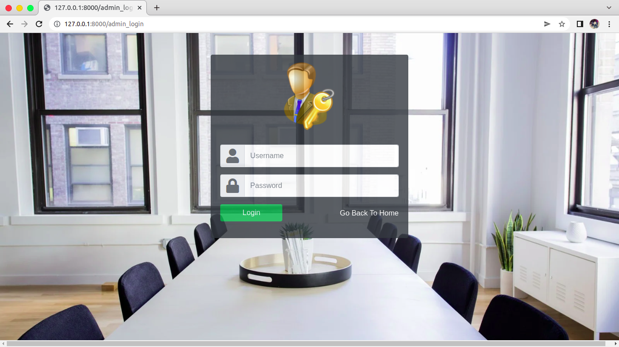
This Page is admin Login

Slide 20
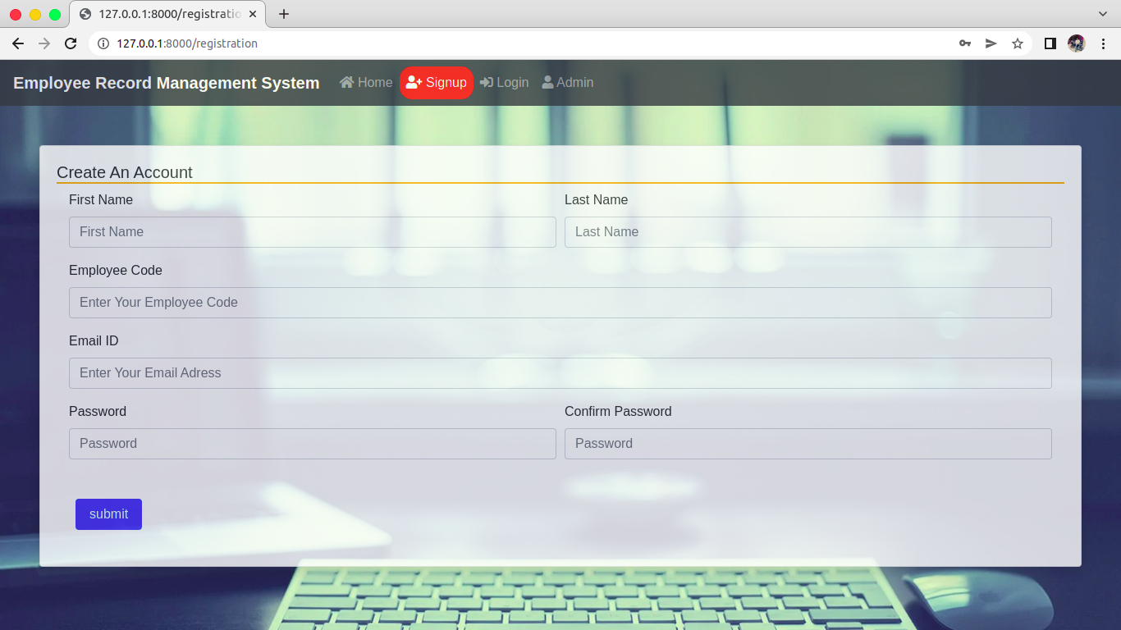
This page is sign_up page

Slide 21
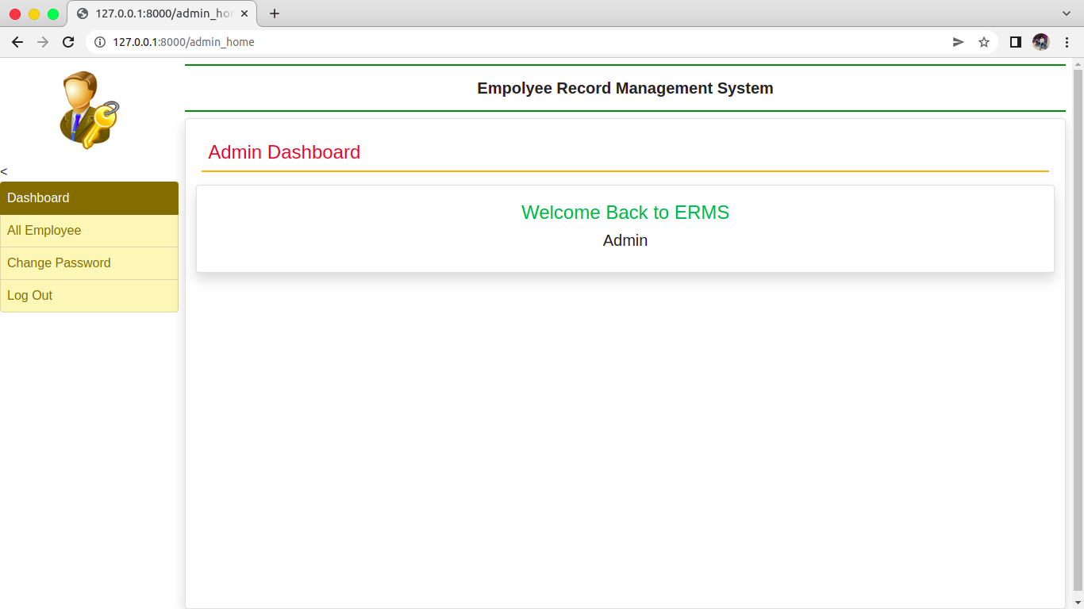
Admin Dashboard

Slide 22
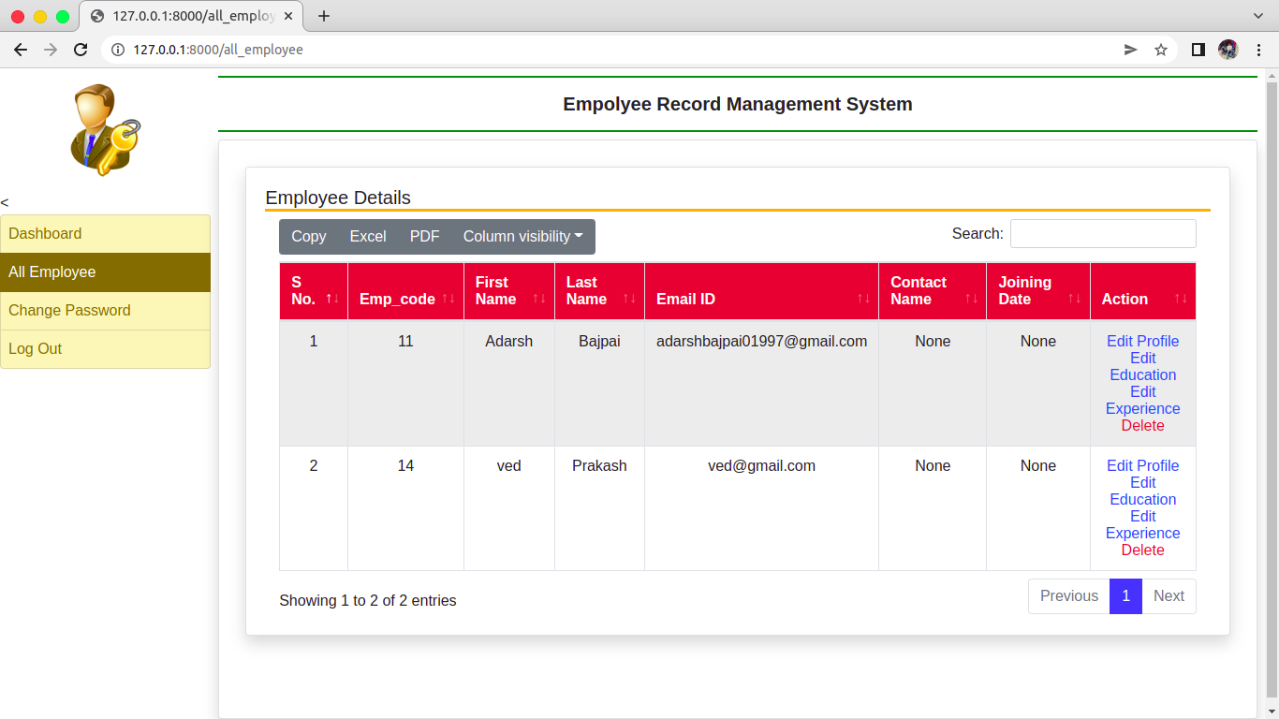
Admin's rights
Edit Profile
Edit Education
Edit Experience detail
change password of user

Slide 23
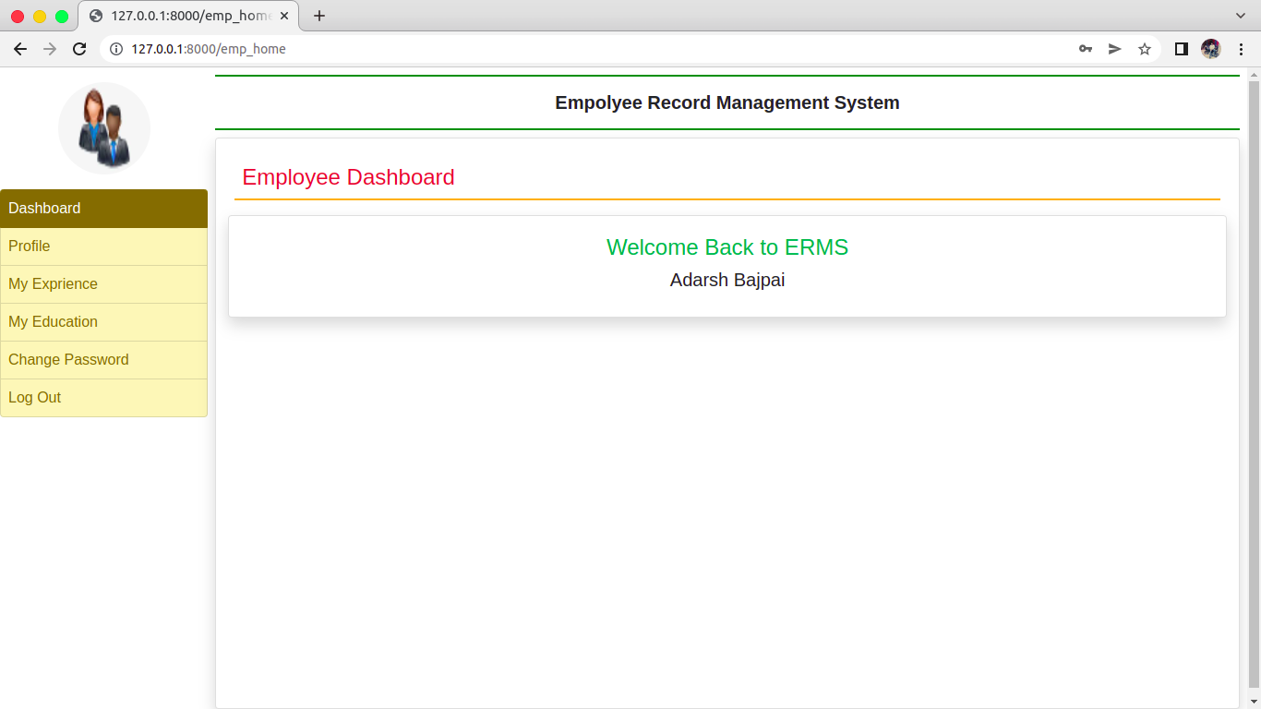
Employee Dashboard

Slide 24
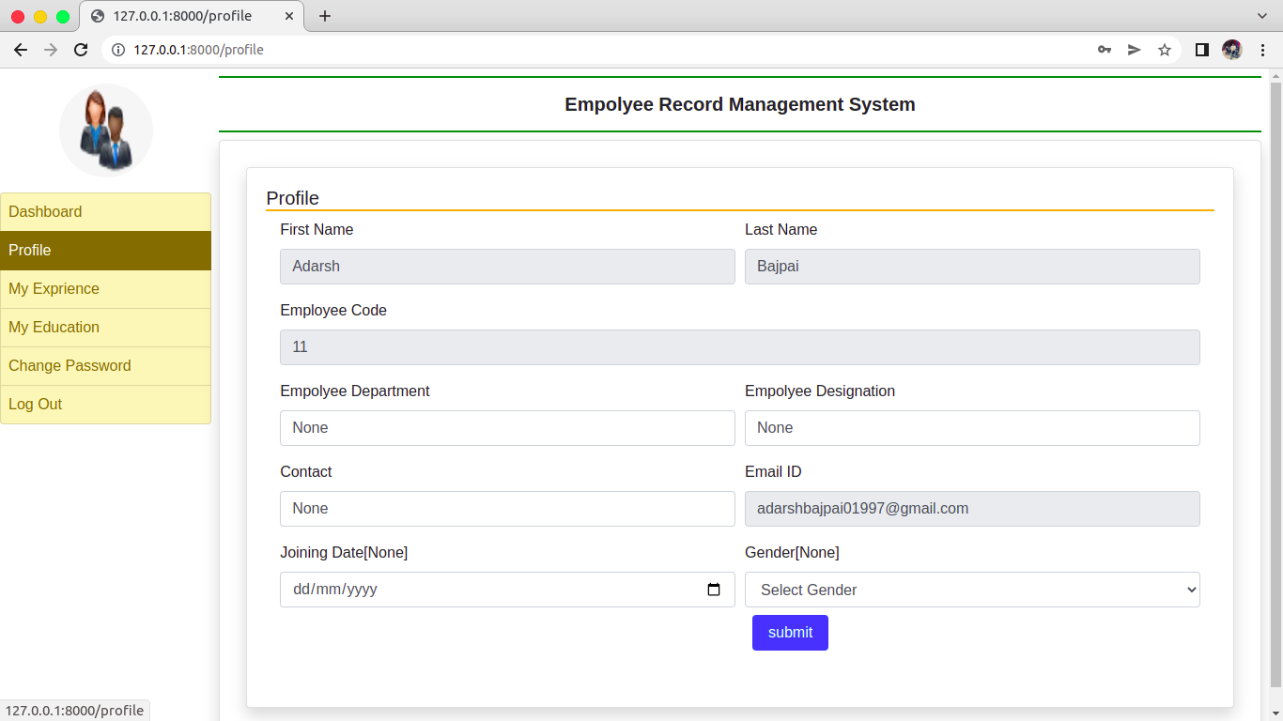
Profile Page

Slide 25
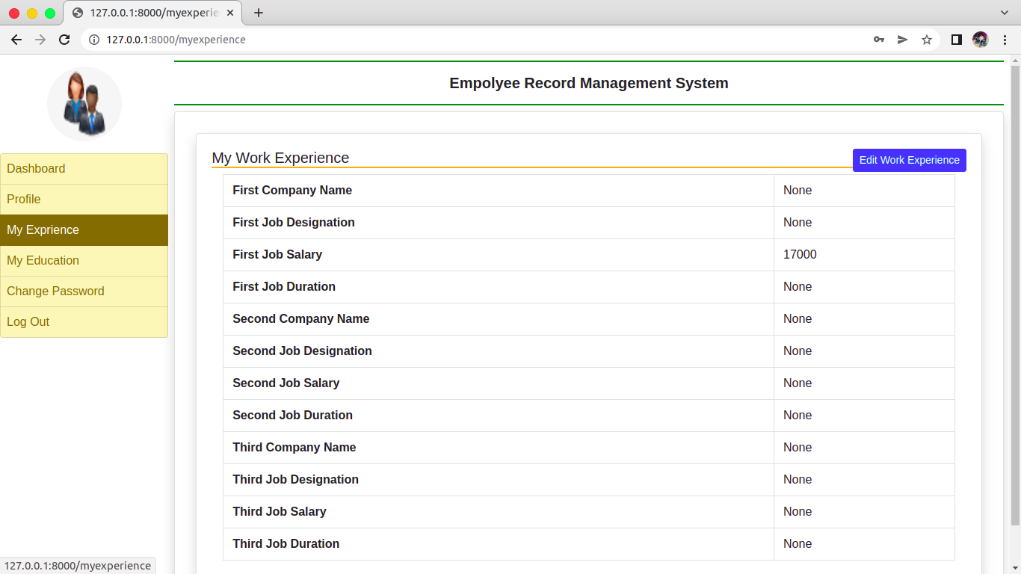
Add Experience Detail page

Slide 26
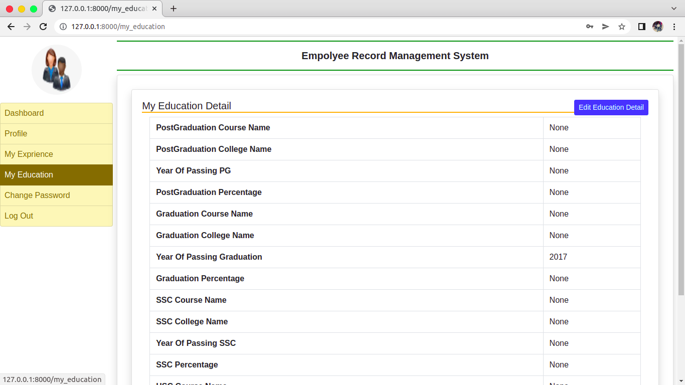
Add Education

Slide 27
Work in progress on 2 models Client and Project Management
Thank You........

